Slide 1
Finance Presentation
BUS 100
Lee Elliott
Notes:
FV = PV (1+r)^{T}

Slide 2
Time Value of Money
Would you rather have 1M today or in 5 years? 100 years? 5 hours?
  Value of a cash flow is based on magnitude, timing and riskiness
  If you win 90M in the lottery, what do you actually get?

Slide 3
Lottery
Powerball Jackpot for Wed, Mar 23, 2018 | $90,000,000 |  | $58,400,000
Gross Prize | 30 average annual payments of $3,000,000 |  | Lump-sum cash: $58,400,000
- 25% Federal Tax | - $750,000 |  | - $14,600,000
Subtotal | $2,250,000 |  | $43,800,000
Notes:
Do you take the lump sum or the payments?

Slide 4
Time Value of Money
Example: You put $1000 in the bank for 5 years at a 6% interest rate
How much interest do you earn per year? Times 5 years = ?
Is this right? Why or why not?
Notes:
Simple interest

Slide 5
TVM: Compounding
Year | investment | calculation
0 (now) | $1000 | 1000 +1000 (.06)=
1 | $1060 | 1060 + 1060(.06)
2 | $1123.60 | 1123.60 + 1123.60 (.06)
3 | $1191.02 | …
4 | $1262.48 | …
5 | $1338.23 | 1262.48 (1.06)
Notes:
Interest on your interest. There is an easier way!

Slide 6
TVM
Lump sum calculation
FV = PV (1+r)^{T}
FV = 1000 (1 + .06)⁵
FV = 1000 (1.33823)
FV = $1338.23

Slide 7
Other calculations for TVM
Present Value
  Given the future value required, calculate the present Value – How much do you need to put in the bank now in order to pay $100 K for college in 18 years? Available interest rate is 8%
Notes:
PV=FV /(1+.08)¹⁸ = $25,024.90

Slide 8

TVM
Annuities
  Regular stream of cash flows over a specified time period
  How much money would you need to save every month in order to have enough money for your child to go to college in 18 years?

Slide 9
The Financial Market Economy
Banks exist because individuals and institutions have different income streams and different intertemporal consumption preferences.
Because of this, a market has arisen for money. The price of money is the interest rate.
Notes:
When you want to spend your money

Slide 10
Example
Consider a dentist who earns $200,000 per year and chooses to consume $80,000 per year. He has $120,000 in surplus money to invest.
He could loan $30,000 to each of 4 college seniors. They each promise to pay him back with interest after they graduate in one year.
Notes:
World without banks

Slide 11
Example
$30,000×(1+r)
Student #1
$30,000
$30,000×(1+r)
Dentist
$30,000
Student #2
$30,000
Student #3
$30,000×(1+r)
$30,000
Student #4
$30,000×(1+r)
Notes:
How could achieve such a thing? Skills required?

Slide 12
Example
Rather than performing the credit analysis 4 times, he could loan the whole $120,000 to a financial intermediary in return for a promise to repay the $120,000 in one year with interest.
The intermediary in turn loans $30,000 to each of the 4 college seniors.

Slide 13
Example
$30,000×(1+r)
Student #1
$120,000
$30,000
$30,000×(1+r)
Dentist
Bank
Student #2
$30,000
$30,000
Student #3
$30,000×(1+r)
$30,000
Student #4
$120,000×(1+r)
$30,000×(1+r)
Notes:
Do all students need exactly 30K? All want 1 year loan? Do all students get the exactly the same rate?

Slide 14
Financial intermediation
Financial intermediation can take three forms:
  Size intermediation
    In the example above, the bank took a large loan from the dentist and made small loans to the students.

Slide 15
Financial intermediation
  Term intermediation
    Commercial banks finance long-term mortgages with short-term deposits.
  Risk intermediation
    Financial intermediaries can tailor the risk characteristics of securities for borrowers and lenders with different degrees of risk tolerance.

Slide 16
Stock Market
Ownership interest in a corporation
  Usually no specified time (unlike debt)
Equity
  What is left over when all liabilities are paid
  Assets - Debt = Equity
  Can to be negative
Notes:
http://www.investopedia.com/video/play/what-are-stocks/
Own the assets and all future cash flow

Slide 17
Stock Market
The “price of a stock” is simply the last price at which a stock was purchased
What causes stock price to change?
Example: you buy 100 shares of Home Depot (HD) for $55.43 per share

Slide 18
Stock Market
Laws of supply and demand
  If more people want it the price goes up
  If fewer investors want to purchase then the price of the stock goes down
So what makes demand rise?
  Investor confidence in Home Depot
Notes:
Tim Hortons

Slide 19
Stock Market
Earnings and company performance
unforeseen events that impact the whole industry or market either positively or negatively
“Black Swan”
Rumours
Notes:
An event that has a large impact and is extremely hard to predict

Slide 20
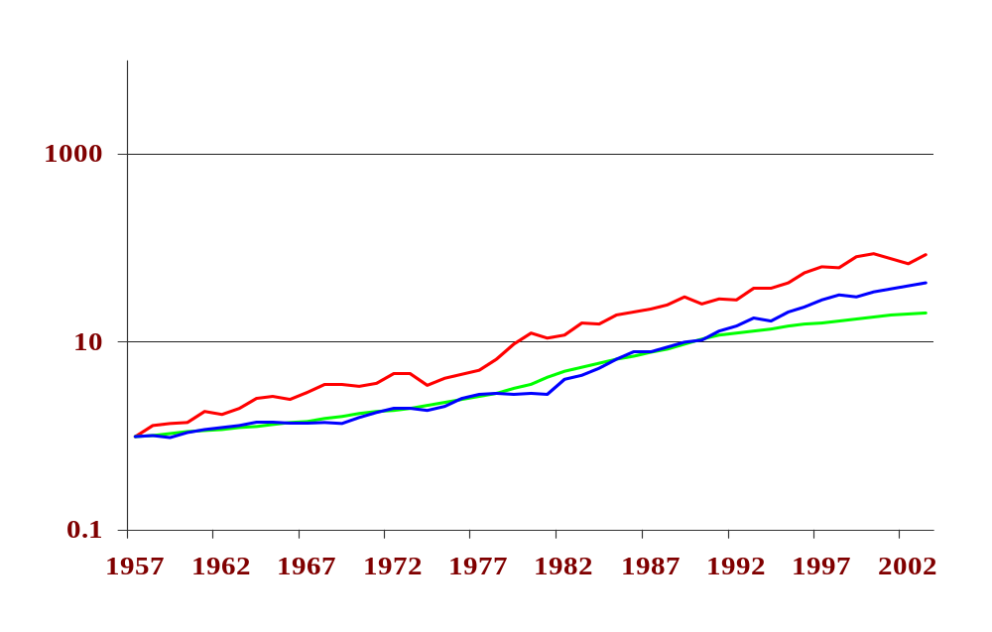
The Future Value of an Investment of $1 in 1957 until 2002
$54.72
$23.43
Common Stocks
Long Bonds
T-Bills
Notes:
(1.11)³⁵ = 38.57 (1.11)²⁵ = 13.59 (1.11)¹⁵ = 4.78 (1.11)¹⁰ =2.59 (1.11)⁵ = 1.68 Risk and Reward

Slide 21
Value of $1 invested
Length of investment | Value of $1
45 years | $107.66
35 years | $38.57
25 years | $13.59
15 years | $4.78
5 years | $1.68
Notes:
(1.11)³⁵ = 38.57 (1.11)²⁵ = 13.59 (1.11)¹⁵ = 4.78 (1.11)¹⁰ =2.59 (1.11)⁵ = 1.68

Slide 22
When should you start saving?
Age when you begin to save | Value of $1
20 years old | $107.66
30 years old | $38.57
40 years old | $13.59
50 years old | $4.78
60 years old | $1.68
Notes:
Assume retire at 65

Slide 23
Risk and Reward
Interest rates
  Mortgage
  Car loan
  Student loan
What do higher rates from bank indicate? Risk!

